Slide 1
Array

Slide 2
Definition – An array is a collection of similar items stored in contiguous memory locations. In programming, sometimes a simple variable is not enough to hold all the data.
Note - A C array has a fixed-size.
Note - Array belongs from non-primitive data structure, which can store the primitive type of data such as int, char, double, float etc.
Note - The array is the simplest data structure where each data element can be randomly accessed by using its index number.
Why do we need arrays?
Arrays are very important in any programming language. They provide a more convenient way of storing variables or a collection of data of a similar data type together instead of storing them separately. Each value of the array will be accessed separately.
Properties – The array contains the following properties -
Each element of an array is of same data type and carries the same size, i.e., int = 4 bytes.
Elements of the array are stored at contiguous memory locations where the first element is stored at the smallest memory location.
Elements of the array can be randomly accessed since we can calculate the address of each element of the array with the given base address and the size of the data element.

Slide 3
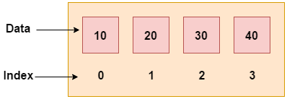
Advantages of Array –
Array elements can be traversed easily.
Easy to manipulate array data.
Array elements can be accessed randomly.
Arrays facilitate code optimization.
Easy to sort array data.
Disadvantages of Array –
An array has a fixed size.
Allocating more memory than the requirement leads to wastage memory space, and less allocation of memory can create a problem.
The number of elements to be stored in an array must be known in advance.

Slide 4
Types of Array – There are two types of array, such as –
1-D array (One Dimensional Array)
2-D array (Multi Dimensional Array)
Declare an Array in C - type array-Name [ array-Size ];
Array Declaration - int arr[10];
Array Initialization - int age[5] = {19, 18, 21, 20, 17}; both are same
int age[] = {19, 18, 21, 20, 17};
Array Initialization –
arr[0] = 19;
arr[1] = 18;
arr[2] = 21;
etc…
Implementation in memory -
address of element a[k] = B + W * k
where, B = Base address
W = Size of each element
k = Number of required element

Slide 5
#include<stdio.h>
#include<conio.h>
void main()
{
int arr[10],i;
printf(“Enter the elements: ”);
for(i=0;i<5;i++)
{
scanf(“%d”, &arr[i]);
}
printf(“The elements are: ”);
for(i=0;i<5;i++)
{
printf(“%d”, arr[i]);
}
getch();
}
- Traversing of an Array –
Algorithm –
Let LB be the lower bound and UB the upper bound of the linear array a.
[Initialize counter] Set i at lower bound LB
Repeat for i = LB to UB
[Visit element]Display a[i]
[End of the loop]
End

Slide 6
One Dimensional Array –
A one-dimensional array in C is a collection of variables of the same type that are stored in contiguous memory locations. It's a way to group multiple values into a single entity that can be easily accessed and manipulated.
This is an array in which the data items are arranged linearly in one dimension only. It is commonly called a 1-D array.
Syntax - datatype array-name[size];
#include<stdio.h>
#include<conio.h>
void main()
{
int i, arr[5] = {10,20,30,40,50};
cout<<"\nArray elements are: ";
for(i=0;i<5;i++)
{
printf(“%d”,arr[i]);
}
}

Slide 7
//Sum of Array Elements
#include<stdio.h>
#include<conio.h>
void main()
{
int arr[6],i,sum=0;
printf("\nEnter the array elements:\n“);
for(i=0;i<6;i++)
{
scanf(“%d”,&arr[i]);
}
for(i=0;i<6;i++)
{
sum = sum + arr[i];
}
printf(“\nSum of Array elements are: %d”, sum);
}

Slide 8
//Find the odd elements in an array
#include<stdio.h>
#include<conio.h>
void main()
{
int arr[6],i,sum=0;
printf("\nEnter the array elements:\n“);
for(i=0;i<6;i++)
{
scanf(“%d”,&arr[i]);
}
for(i=0;i<6;i++)
{
if(arr[i]%2!=0)
{
printf(“%d”,arr[i]);
}
}
}

Slide 9
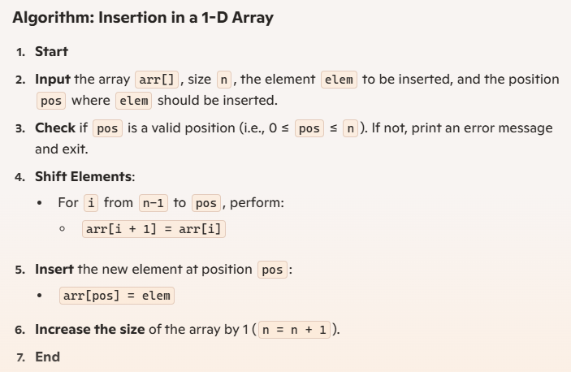
INSERTION IN 1-D ARRAY–

Slide 10
void insertElement(int arr[], int *n, int elem, int pos)
{
if (pos < 0 || pos > *n)
{
printf("Invalid position!\n");
return;
}
for (int i = *n - 1; i >= pos; i--)
{
arr[i + 1] = arr[i];
}
arr[pos] = elem;
*n = *n + 1;
}

Slide 11
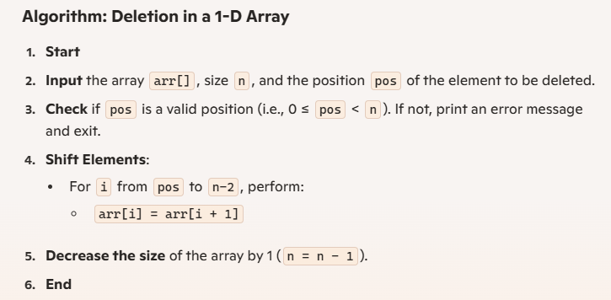
-DELETION IN 1D ARRAY–
void delete(int arr[], int n, int pos)
{
if (pos < 0 || pos >= n)
{
printf("Invalid position!\n");
return;
}
for (int i = pos; i < n - 1; i++)
{
arr[i] = arr[i + 1];
}
n = n - 1;
}

Slide 12
